Slide 1
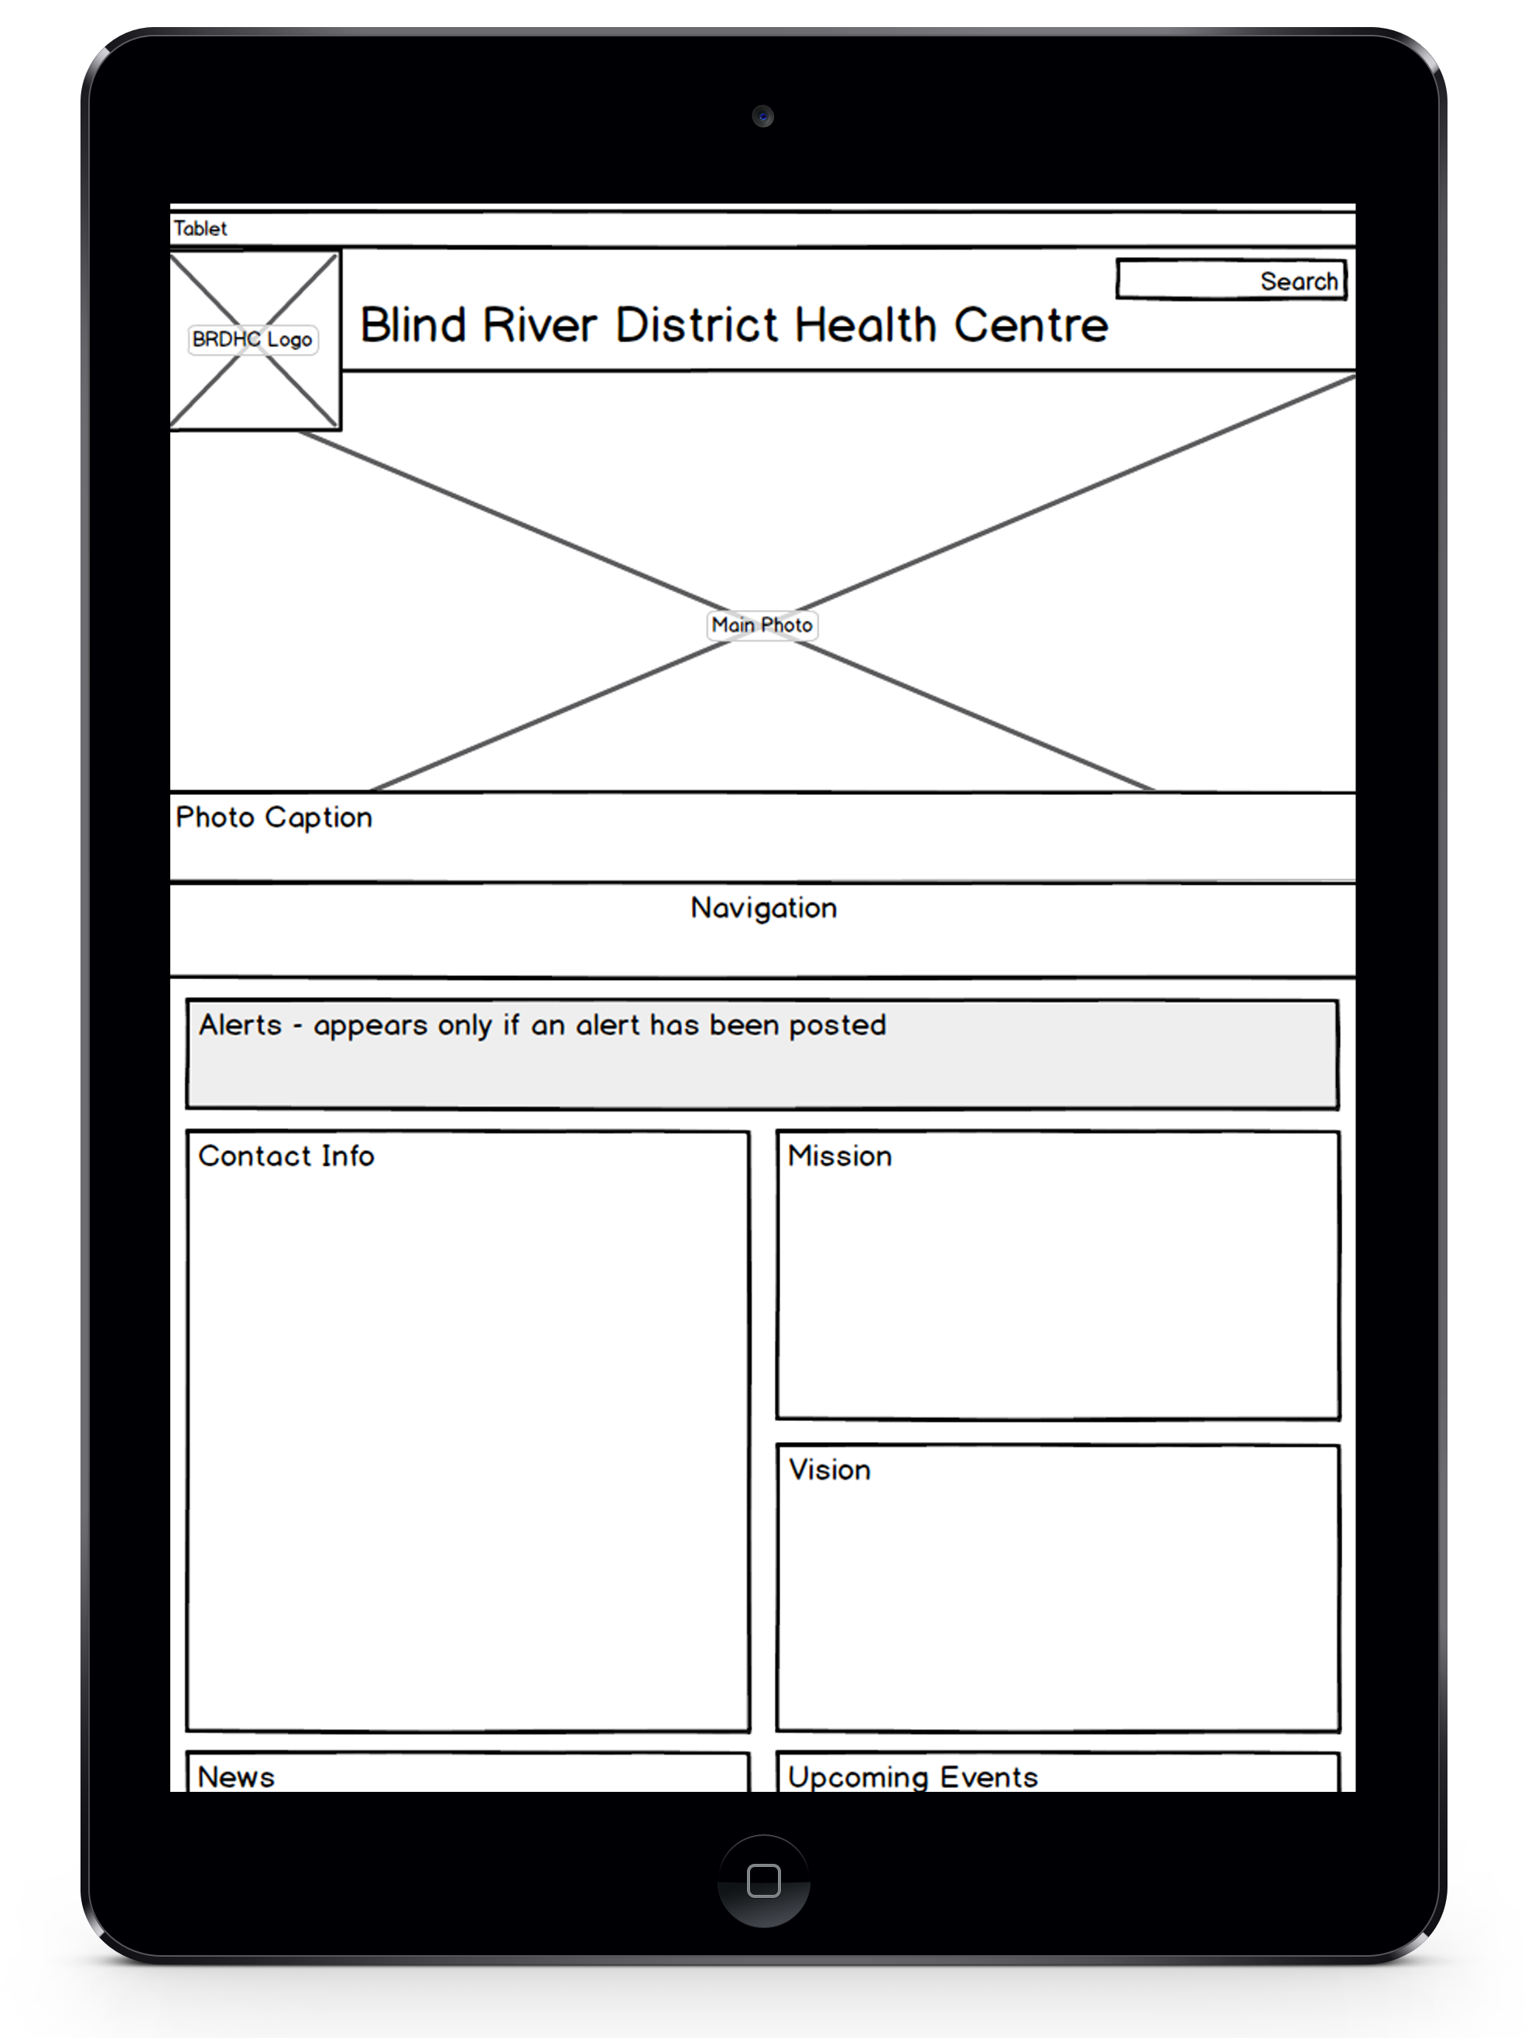
Blind River District Health Centre
Wireframes
Team 3:
Ryan
Reshma
Krunal
Marki
Jesse

Slide 2
Agenda
What is Responsive Web Design?
Devices
Browsers
BRDHC Wireframes
Moving forward
Conclusions

Slide 3
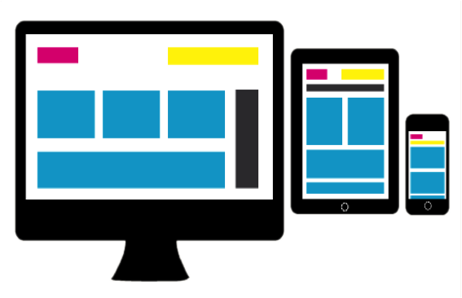
What is RWD?
Responsive Web Design (RWD)
Allows you to tailor a site’s layout & interfaces to suit various devices.
Adaptable Layout
Content
Functionality

Slide 4
What is RWD?
Present Day Scenario
Different browers and devices
Smart devices increasing quickly
Plenty of users visit websites using mobile

Slide 5
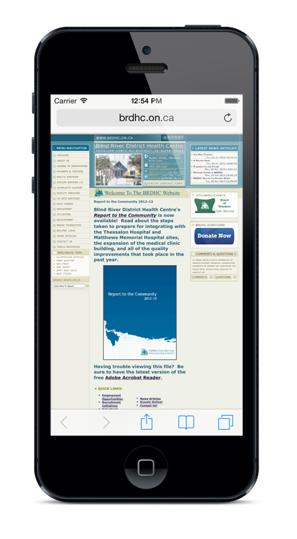
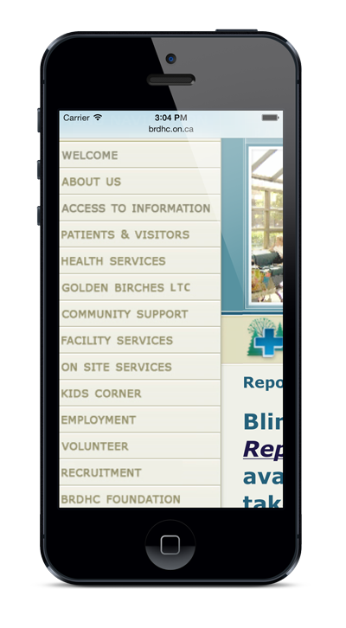
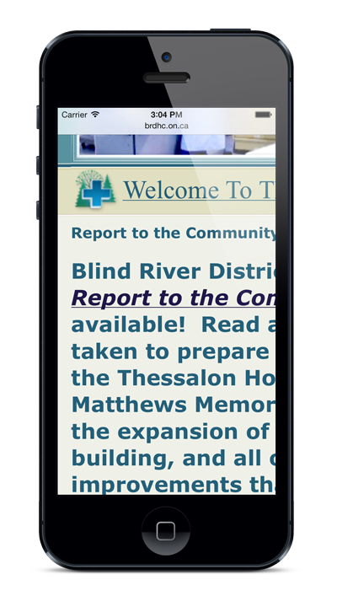
What is RWD?
Just because you can open a site on mobile, does mean it’s mobile friendly
HOW

Slide 6

Technology & Users

Slide 7
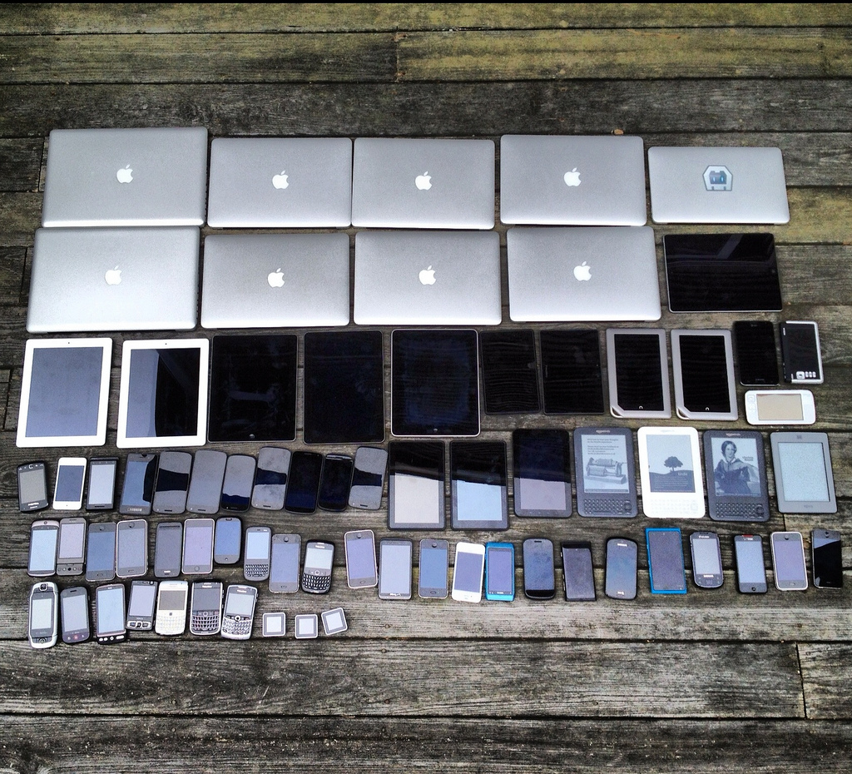
Devices
RWD

Slide 8

HOW DO WE DO IT?

Slide 9



Browsers
Internet Explorer
Mozilla Firefox
Google Chrome

Slide 10
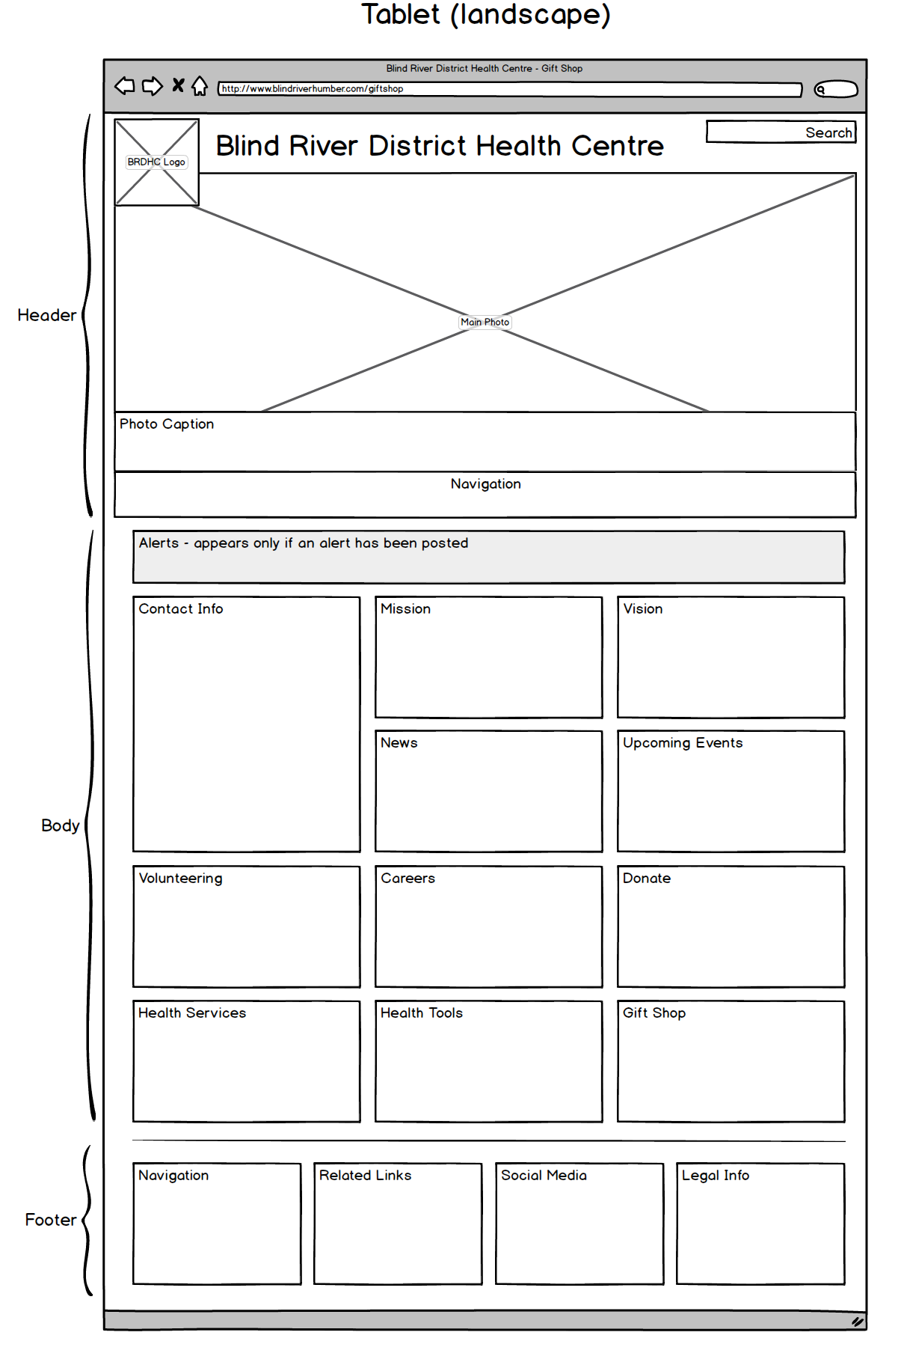
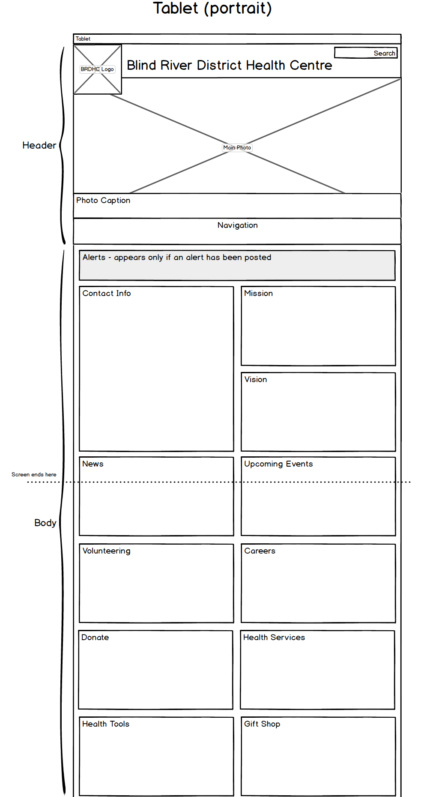
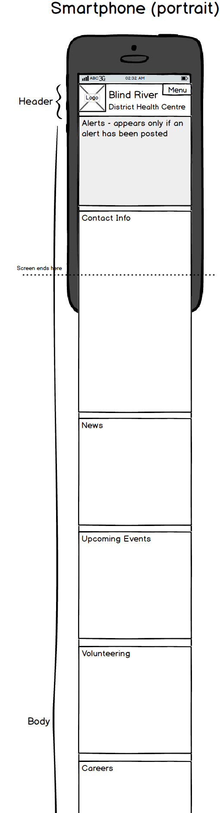
Wireframes

Slide 11
Moving forward
Questions
Feedback

Slide 12
THANK YOU!
Blind River District Health Centre

